Slide 1

TE3
Transforming Evaluation
Experience

Slide 2
Agenda
Introduction
Meet the team
Motivation
Tech stack & Solution
Challenges & next steps

Slide 3
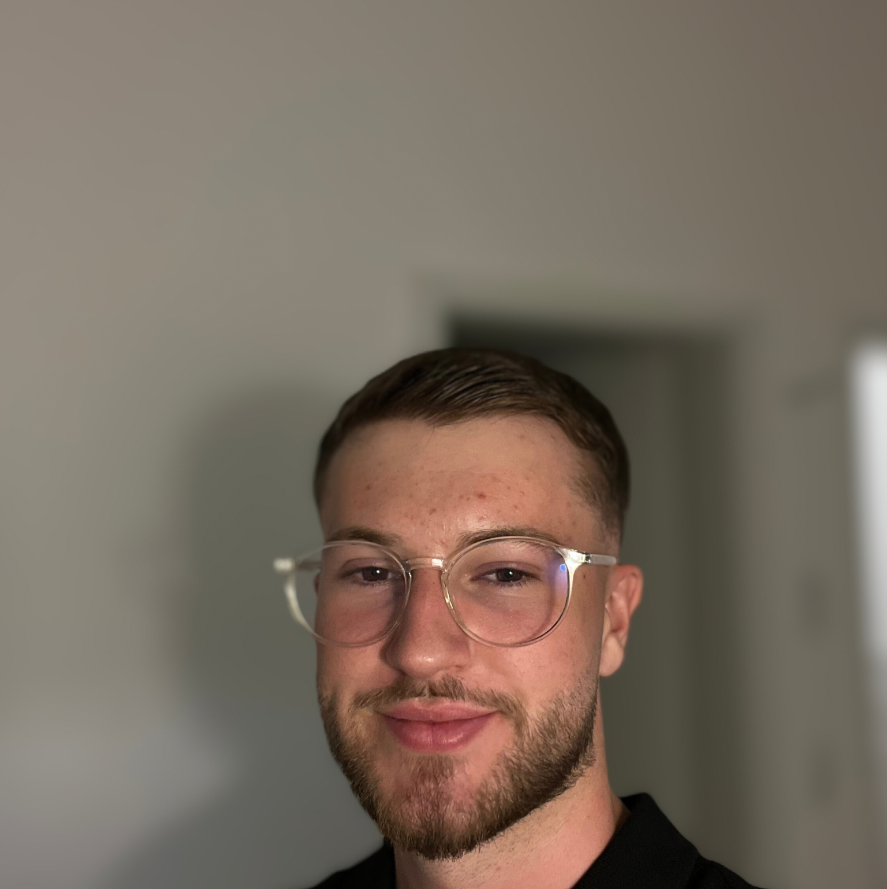
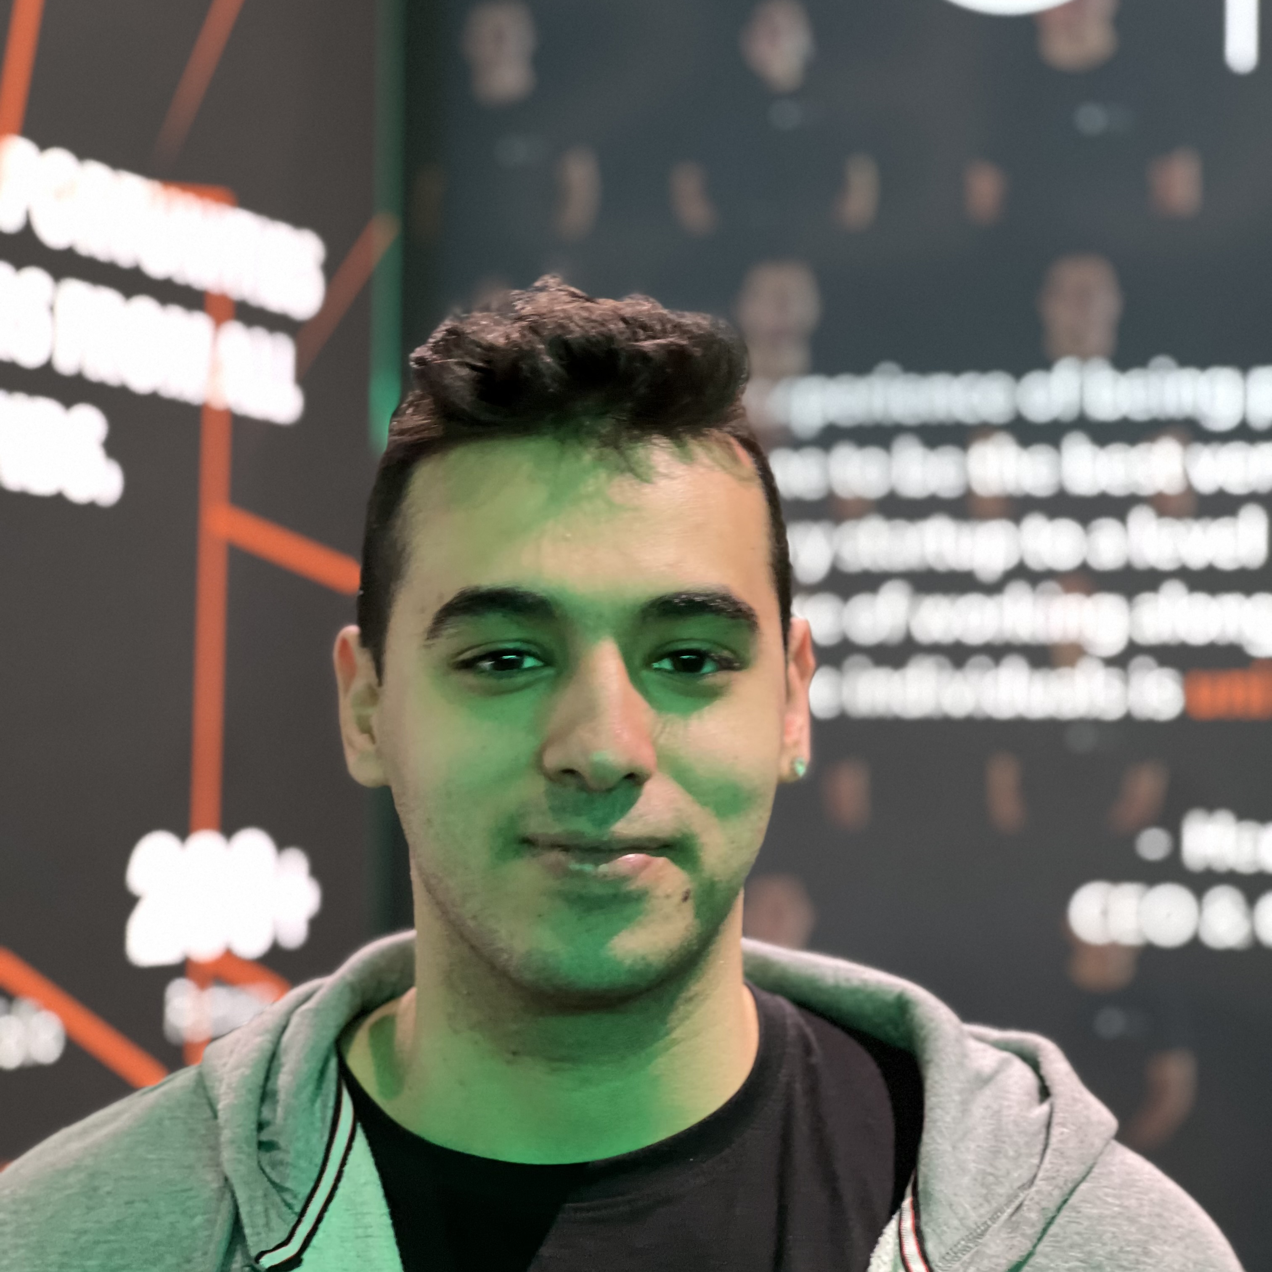

Meet the Team
Feres Essafi
Frontend lead, design
Salih Uyar
Data Management, Frontend dev
Yahia ElSaman
Design, Frontend dev

Slide 4

Motivation
Teachers overwhelmed
Overcome the educational setbacks of COVID-19
Goal:
optimize evaluation process

Slide 5
Our Solution
Developed a webapp for quick and simple access to student records to assist teachers
Criteria:
Simple and intuitive to use
clear and concise information briefly
Deployable and Scalable

Slide 6



Tech Stack & Live Demo
Tailwind CSS
Vue.js
Nuxt

Slide 7
Challenges,
next steps
Use AI to personalize recommendations
Student and Parent insights
Class wide Analysis

